Slide 1
Experiential: Mindfulness Practice
Coast Guard Operational
Stress Control (CG -0SC )
Notes:
Experiential: Mindful Practice

Slide 2
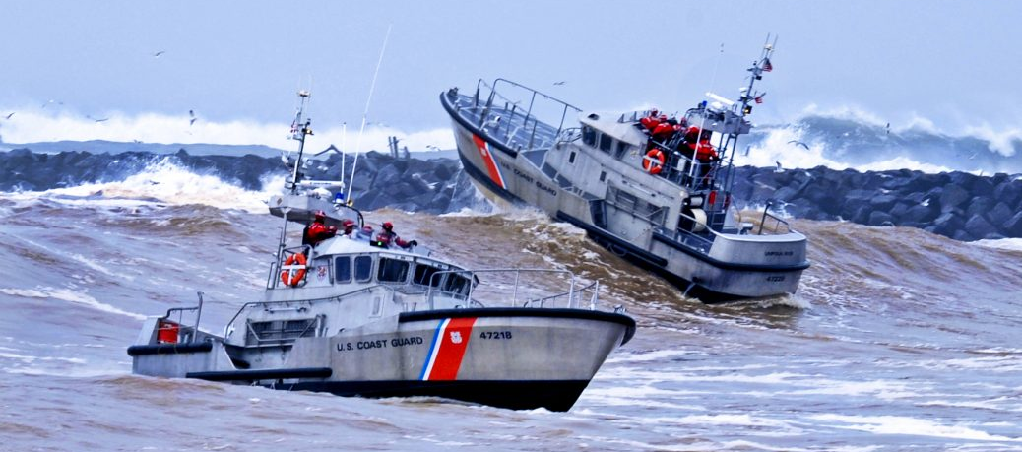
Mindfulness 1-24-22 TM
Notes:
Mindfulness

Slide 3
Learning Objectives
Coast Guard Operational
Stress Control (CG -0SC )
DEFINE and EXPLAIN mindfulness
IDENTIFY and DISCUSS the benefits to practicing mindfulness
EXPLAIN where you can find additional mindfulness resources
DEMONSTRATE how to perform mindfulness experientials
Notes:
Learning Objectives
DEFINE and EXPLAIN what mindfulness
IDENTIFY and DISCUSS the benefits to practicing different mindfulness practices
EXPLAIN where you can find additional mindfulness resources
DEMONSTRATE how to perform mind body experientials

Slide 4
What is Mindfulness?
Coast Guard Operational
Stress Control (CG -0SC )
A mental state achieved by intentionally focusing one’s awareness on the present moment (getting off autopilot to participate and be present in our own lives)
Internal: thoughts, emotions, bodily sensations
External: the world around you (sights, sounds, smells)
Accepting one’s feelings, thoughts and physical sensations
A non-judgmental attitude of present moment experiences or events
Experiential: you have to do it to understand what it is and practice regularly to notice the benefits
Notes:
What is Mindfulness?
Discussion Questions:
-What comes to mind when you hear the term mindfulness?
-What does running on auto-pilot mean to you?
A mental state achieved by intentionally focusing one’s awareness on the present moment (getting off autopilot to participate and be present in our own lives)
Internal: thoughts, emotions, bodily sensations
External: the world around you (sights, sounds, smells)
Accepting one’s feelings, thoughts and physical sensations
A non-judgmental attitude of present moment experiences or events
Allow your experiences to be what they are, "it is what it is"
Experiential: you have to do it to understand what it is and practice regularly to notice the benefits

Slide 5
Practice, Practice, Practice…
Coast Guard Operational
Stress Control (CG -0SC )
Start small; 5-10 minutes per day
Set reminders to practice until you have created a new habit
Have patience
If mind wanders (which it will), gently bring it back
Find creative solutions
Use the skills you already have
Intentionally bring more awareness to your daily activities:
Noticing one new thing “on watch”
During colors
Driving
Prayer
Repeat. Keep doing this over and over!
Notes:
Practice, Practice, Practice
Discussion Questions:
-What do you think will be the hardest part of practicing mindfulness?
-What are the daily activities you currently do, where you can incorporate practicing mindfulness?
Mindfulness requires practice (similar to the way that fitness is an approach to train the body). Results are not instant, and you will have to practice regularly in order to see the benefits. Think of it like going to the gym, you can't go to the gym once thinking that you will see instant results. You need to develop a regular practice and the best way to ensure you develop that regular practice is to incorporate it into your day-to-day routine. The best opportunities to practice mindfulness will often occur during day-to-day experiences (ex. stuck in traffic). Using informal opportunities to practice acting mindfully will help you to develop a habit of responding more mindfully to stressful situations.
Start small; 5-10 minutes per day
Set reminders to practice until you have created a new habit
Have patience
If your mind wanders (which it will), gently bring it back
Find creative solutions
Use the skills you already have (exercise, music, walking, prayer)
Intentionally bringing more awareness to your daily activities:
Noticing one new thing “on watch”
During colors
Driving
Prayer
Repeat. Keep doing this over and over!

Slide 6
Benefits of Practicing Mindfulness
Coast Guard Operational
Stress Control (CG -0SC )
Increase confidence Recognize stress before it becomes a problem Help you relax, and/or fall asleep Improve performance Improve concentration, focus & memory ACT instead of REACT | Improve your ability to remain calm under pressure Promote physical health Manage pain Decrease suffering Help understand and manage extreme emotions Increase happiness
Notes:
Benefits to Practicing Mindfulness
Mindfulness helps you to “rewire” and develop stronger pathways to areas of the brain responsible for “higher-order functions” including attention, reasoning, planning, problem-solving, and emotion regulation. Mindfulness is not the brain at rest, it is the brain focused. Studies show that during formal mindfulness-based meditations, various regions of the brain become activated.
Mindfulness helps with the restoration process in all four domains (mind, body, spirit, social)
Recognize stress before it becomes a problem
Improve your ability to handle stress, remain calm under pressure, regain and maintain focus
Help you relax and/or fall asleep
Improve performance
Improve concentration, focus & memory
ACT instead of REACT
Promote physical health
Manage pain
Decrease suffering
Increase happiness

Slide 7
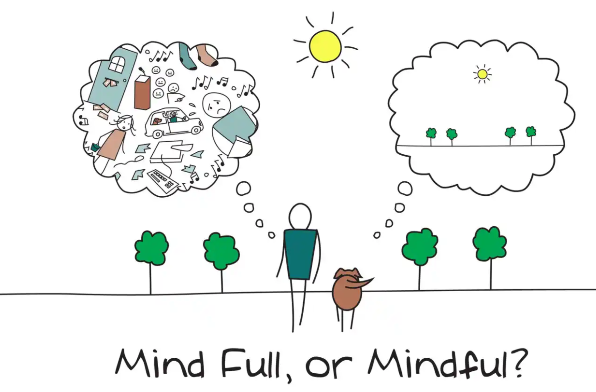
Mindfulness Experientials
Coast Guard Operational
Stress Control (CG -0SC )
Meditation
Diaphragmatic Breathing
Recalibration
Body Scan
Progressive Muscle Relaxation
Imagery/Visualization
Yoga
Spirituality/Prayer
Notes:
Mindfulness Experientials
Instructor Note:
We will be practicing a mindfulness experiential at the end of this module.
Here are some examples of mindfulness experientials that we will be discussing and practicing throughout this training.
Meditation
Diaphragmatic Breathing
Recalibration
Body Scan
Progressive Muscle Relaxation-How to do Progressive Muscle Relaxation - YouTube
Imagery/Visualization
Yoga
Spirituality/Prayer
How to achieve high performance under stress | Jannell MacAulay | TEDxABQ - YouTube

Slide 8
Mindfulness Experientials
Coast Guard Operational
Stress Control (CG -0SC )
Meditation
A technique to train the mind to increase attention, awareness, and achieve a mentally clear and emotionally calm state (grounding techniques, transcendental, repetitive thought, mantra repetition)
Diaphragmatic Breathing (belly breathing/abdominal breathing)
Controlled breathing through diaphragmatic (deep), rhythmic inhales and exhales
Recalibration
A quick paced breathing technique that can help manage physiological arousal, and improve focus, attention and performance
Body Scan
Scanning your body to focus your attention on different parts of the body in sequence
To notice the sensations in each part of the body at a given moment
Notes:
Mindfulness Experientials
There are many different ways to practice mindfulness. It all depends on what your intention is. Here are examples of some techniques. If one technique does not work for you, try another and find the one that does.
Meditation: A technique to train the mind to increase attention, awareness, and achieve a mentally clear and emotionally calm state (transcendental, repetitive thought, mantra repetition)
Diaphragmatic Breathing (belly breathing/abdominal breathing): Controlled breathing through diaphragmatic (deep), rhythmic inhales and exhales initiates a relaxed state in the body and may assist in focusing the mind. The breath is the foundation of most relaxation techniques.
Recalibration: A quick paced breathing technique that can help manage physiological energy, and improve focus, attention and performance
Body Scan: Scanning your body to focus your attention on different parts of the body in sequence. To notice the sensations in each part of the body at a given moment

Slide 9
Mindfulness Experientials
Coast Guard Operational
Stress Control (CG -0SC )
Progressive Muscle Relaxation
A way to notice the difference between tension and relaxation and control your level of arousal by controlling physical tension
Imagery/Visualization
The practice of creating detailed thoughts and pictures in your mind using all of the senses, not just visualization
Yoga
Stretching and holding the body steady and comfortable in specified postures and releasing body tension, using breathing techniques to deepen the relaxation
Prayer
Focusing on a spiritual word, or brief prayer that you repeat silently to yourself to calm the body, quiet the mind and improve concentration to restore the spirit
Notes:
Mindfulness Experientials
Progressive Muscle Relaxation: A way to notice the difference between tension and relaxation and control your level of arousal by controlling physical tension
Imagery/Visualization: The practice of creating detailed thoughts and pictures in your mind using all of the senses, not just visualization
Yoga: Stretching and holding the body steady and comfortable in specified postures and releasing body tension, using breathing techniques to deepen the relaxation
Prayer: Focusing on a spiritual word, or brief prayer that you repeat silently to yourself to calm the body, quiet the mind and improve concentration to restore the spirit

Slide 10
Coast Guard Operational
Stress Control (CG -0SC )
Video: Meditation 101
Notes:
Video: Meditation 101
Title: Meditation 101: A Beginner's Guide
Description: An overview of the basic techniques of meditation while addressing biases that prevent people from practicing meditation
Source: Happify Health inc.
Link: https://www.youtube.com/watch?v=o-kMJBWk9E0
Time Allotted: 2 minutes
Discussion Questions:
-What are your thoughts on this video?
-What do you think will be the hardest part of learning to meditate?

Slide 11
Mindfulness Resources
Coast Guard Operational
Stress Control (CG -0SC )
Mindfulness Coach 2 App Mindfulness Coach 2 was developed to help service members learn how to practice mindfulness. https://mobile.va.gov/app/mindfulness-coach
Breath2Relax App: Breathe2Relax offers information about the effects of stress on the body and guides users through a number of relaxation breathing techniques National Center for Telehealth & Technology (T2): http://t2health.dcoe.mil/apps/breathe2relax
Insight Timer Free Mindfulness App, to help with sleep and total mindfulness HTTPS://INSIGHTTIMER.COM
Notes:
Mindfulness Resources
There are a ton of books, apps and resources online that provide additional information and guidance on learning and practicing mindfulness. Below are a list of free mindfulness practice resources designed for military personnel.
Mindfulness Coach 2 App: Mindfulness Coach 2 was developed to help service members learn how to practice mindfulness. The app provides a gradual, self-guided training program designed to help you understand and adopt a simple mindfulness practice.
U.S. Department of Veterans Affairs (VA): https://mobile.va.gov/app/mindfulness-coach
Breath2Relax App: Breathe2Relax offers information about the effects of stress on the body and guides users through a number of relaxation breathing techniques
National Center for Telehealth & Technology (T2): http://t2health.dcoe.mil/apps/breathe2relax
Insight Timer Free Mindfulness App, to help with sleep and total mindfulness HTTPS://INSIGHTTIMER.COM

